Slide 1
A Glimpse Behind the Veil
Revelation 1:1-8

Slide 2
Revelation 1:1-8
Apocalypse = a “bloodbath”? a “meltdown” ?

Slide 3
Revelation 1:1-8
It’s about worship
who we really worship

Slide 4
Revelation 1:1-8
It’s about worship
who we really worship
worship is always reactive

Slide 5
Revelation 1:1-8
It’s about worship
It’s about thrones

Slide 6
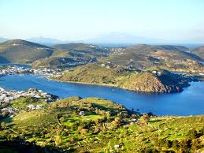
Patmos

Slide 7
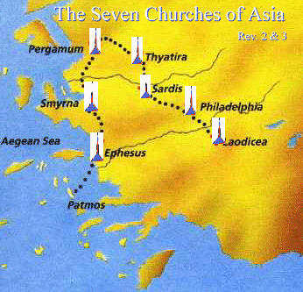
The seven churches

Slide 8
What is this book?
A revelation (1:1,2)

Slide 9
What is this book?
A revelation (1:1,2)
A revelation of Jesus Christ

Slide 10
What is this book?
A revelation (1:1,2)
A revelation of Jesus Christ
A revelation about God – the one “seated upon the throne”

Slide 11
What is this book?
A revelation (1:1,2)
An Apocalypse

Slide 12
What is this book?
A revelation (1:1,2)
An Apocalypse
Spiritual conflict

Slide 13
What is this book?
A revelation (1:1,2)
An Apocalypse
Spiritual conflict
Relationship between heaven & earth

Slide 14
What is this book?
A revelation (1:1,2)
An Apocalypse
Spiritual conflict
Relationship between heaven & earth
Historical context = the Roman empire

Slide 15
What is this book?
A revelation (1:1,2)
An Apocalypse
Spiritual conflict
Relationship between heaven & earth
Historical context – Roman empire
Compare Daniel in Babylon

Slide 16
What is this book?
A revelation (1:1,2)
An Apocalypse
Spiritual conflict
Relationship between heaven & earth
Historical context – Roman empire
Compare Daniel in Babylon
In Revelation: 2 colonies and 2 cities

Slide 17
What is this book?
A revelation (1:1,2)
An Apocalypse
A prophecy (v.3)
“blessed is the one who reads aloud the words of this prophecy, and blessed are those who hear, and those who keep what is written in it, for the time is near.” (ESV)

Slide 18
What is this book?
A revelation (1:1,2)
An Apocalypse
A prophecy (v.3)
A letter (v.4)
“John, to the seven churchs that are in Asia”

Slide 19
What is this book?
The Trinitarian God

Slide 20
What is this book?
The Trinitarian God
The salutation (greeting) 1:4b-5a
“Grace and peace…

Slide 21
What is this book?
The Trinitarian God
The salutation (greeting) 1:4b-5a
from the Father – who is and who was…

Slide 22
What is this book?
The Trinitarian God
The salutation (greeting) 1:4b-5a
from the Father – who is and who was and who is to come…

Slide 23
What is this book?
The Trinitarian God
The salutation (greeting) 1:4b-5a
The Father – who is and who was and who is to come…
The Spirit – …and from the seven spirits who are before his throne

Slide 24
What is this book?
The Trinitarian God
The salutation (greeting) 1:4b-5a
The Father
The Spirit
The Son

Slide 25
What is this book?
The Trinitarian God
The salutation (greeting) 1:4b-5a
The Father
The Spirit
The Son
the faithful witness

Slide 26
What is this book?
The Trinitarian God
The salutation (greeting) 1:4b-5a
The Father
The Spirit
The Son
the faithful witness
the firstborn from the dead

Slide 27
What is this book?
The Trinitarian God
The salutation (greeting) 1:4b-5a
The Father
The Spirit
The Son
the faithful witness
the firstborn from the dead
Ruler of the kings of the earth

Slide 28
What is this book?
The Trinitarian God
The doxology (v.5b-6)
To him who loves us and has freed us from our sins by his blood and made us a kingdom, priests to his God and father, to him be glory and dominion forever and ever. Amen.

Slide 29
What is this book?
The Trinitarian God
The doxology (v.5b-6)
Old Testament quotes
Daniel 7:13
Zachariah 12:10

Slide 30
What is this book?
The Trinitarian God
The doxology (v.5b-6)
Old Testament quotes
The First and the Last
The Alpha and Omega 1:8; 1:17; 22:13.

Slide 31
What is this book?
The Trinitarian God
The doxology (v.5b-6)
Old Testament quotes
The First and the Last
The Alpha and Omega 1:8; 1:17; 22:13.
The Almighty

Slide 32
Conclusion
Bad things happen to faithful people

Slide 33
Conclusion
Why do we meet?

Slide 34
Conclusion
Why do we meet?
We come to worship

Slide 35
Conclusion
Why do we meet?
We come to worship
We come because of who is on the throne

Slide 36
Conclusion
Why do we meet?
We come to worship
We come because of who is on the throne
We come because He has made us a kingdom and priests

Slide 37
Conclusion
Why do we meet?
We come to worship
We come because of who is on the throne
We come because He has made us a kingdom and priests
We come to be nourished so that we may be faithful witnesses

